Slide 1
Algorithm Visualizer
The visual representation of algorithms

Slide 2
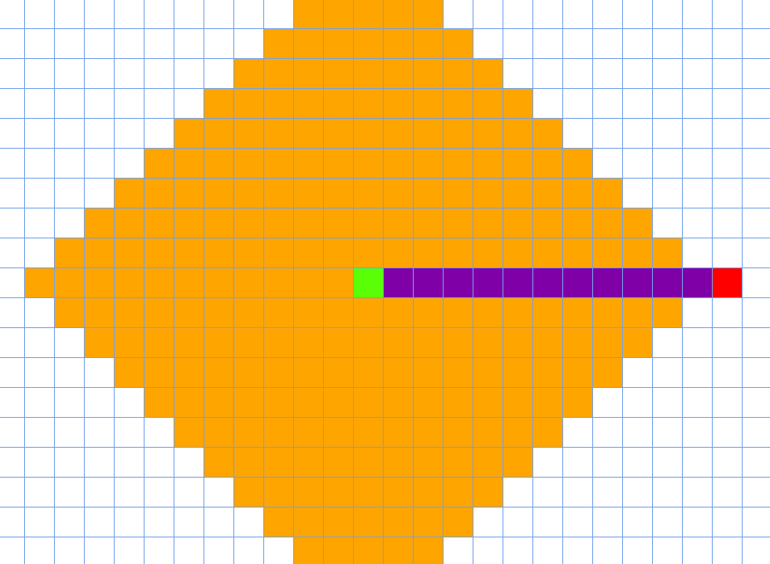
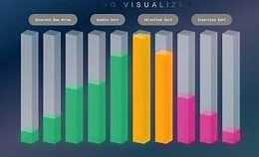
Introduction
Algorithms are important for computer science and essential to solving various field issues.
They offer a systematic and organized strategy for dealing with complicated problems.
They provide abilities beyond computers, such as logic, efficiency, and critical thinking.
Sorting algorithms are a common component of modern computer software.
The main aim of this is to create a program that would serve as a tool for understanding how most known sorting algorithms work there was an attempt to make the best possible user experience.

Slide 3
Literature Survey
We referred to research papers for our research and to gain an understanding of algorithm visualizes, their importance, existing systems, and their limitations. Here are the referred papers.
Research paper of International Research Journal of Modernization in Engineering Technology and Science - . The paper focuses primarily on the A* algorithm and other algorithms due to its flexibility in finding the available shortest path.
N. Yadav and associates in 2021, created a "Path Finding Visualizer" a web-based e-learning tool that visually demonstrates various shortest path algorithms. They implement popular algorithms using HTML, CSS, JavaScript, and the React Framework.
Arijit Goswami, Biswarup Bhattacharjee, Rahul Debnath, Ankita Sikder, it presents main purpose of this paper is to ensure effective and reliable methods of detecting various algorithms. Using this web application anyone can learn algorithms quickly and easily. Such applications are already available, but the efficiency of the available algorithm visualizers is not achieved thoroughly.

Slide 4
Problem definition
Algorithm Visualizer is to provide an interactive tool that visually represents the execution of algorithms, allowing users to better understand how algorithms work, step-by-step, in real-time. It serves as an educational tool for students, educators, and anyone interested in learning about algorithms in computer science.

Slide 5
Objectives
Enhance Understanding: To make complex algorithms more accessible by providing clear visual representations of their processes and structures.
Facilitate Learning: To support students and learners in grasping algorithmic concepts through interactive and engaging methods, fostering deeper comprehension.
Promote Experimentation: To allow users to manipulate input data and parameters, enabling them to observe how changes affect the algorithm's performance and behavior in real-time.

Slide 6
Methodology
Web Styling languages HTML/CSS: These fundamental web technologies is used create a user-friendly interface and visually appealing styling for the Algorithm Visualizer.
HTML structures the content, defining elements like buttons, grids, and input forms. At the same time, CSS ensures a polished look and feel, providing responsive design for various screen sizes and devices.
Scripting Languages and Frameworks JavaScript: As the backbone of interactivity, JavaScript empowers the Algorithm Visualizer by handling user interactions, orchestrating algorithm visualization, and controlling animations.
It enable sorting and path-finding algorithms, from selecting algorithms to altering array sizes and adjusting visualization speeds.
React: A prominent front-end library; React is our project's core.
Reacts component-based architecture facilitates the creation of reusable UI elements, allowing for modular development and efficient state management.

Slide 7
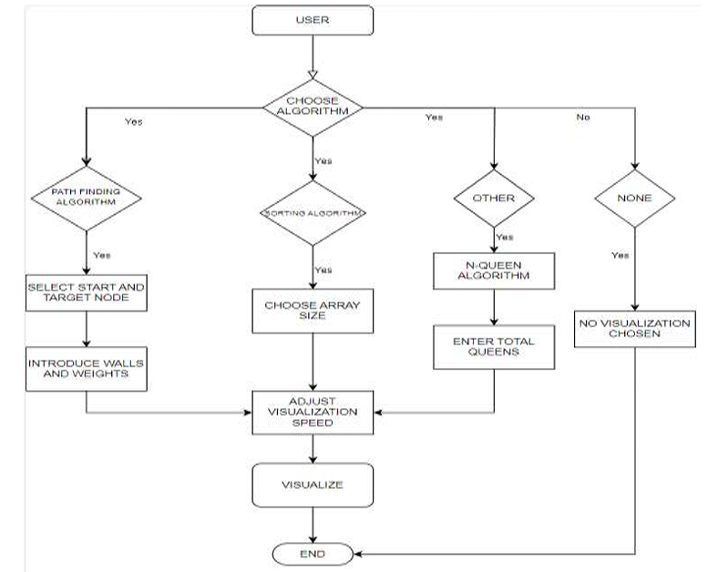

Slide 8
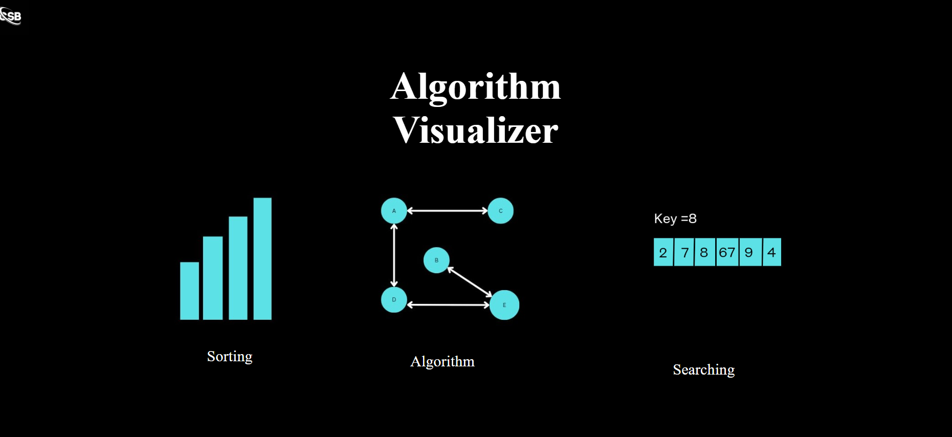
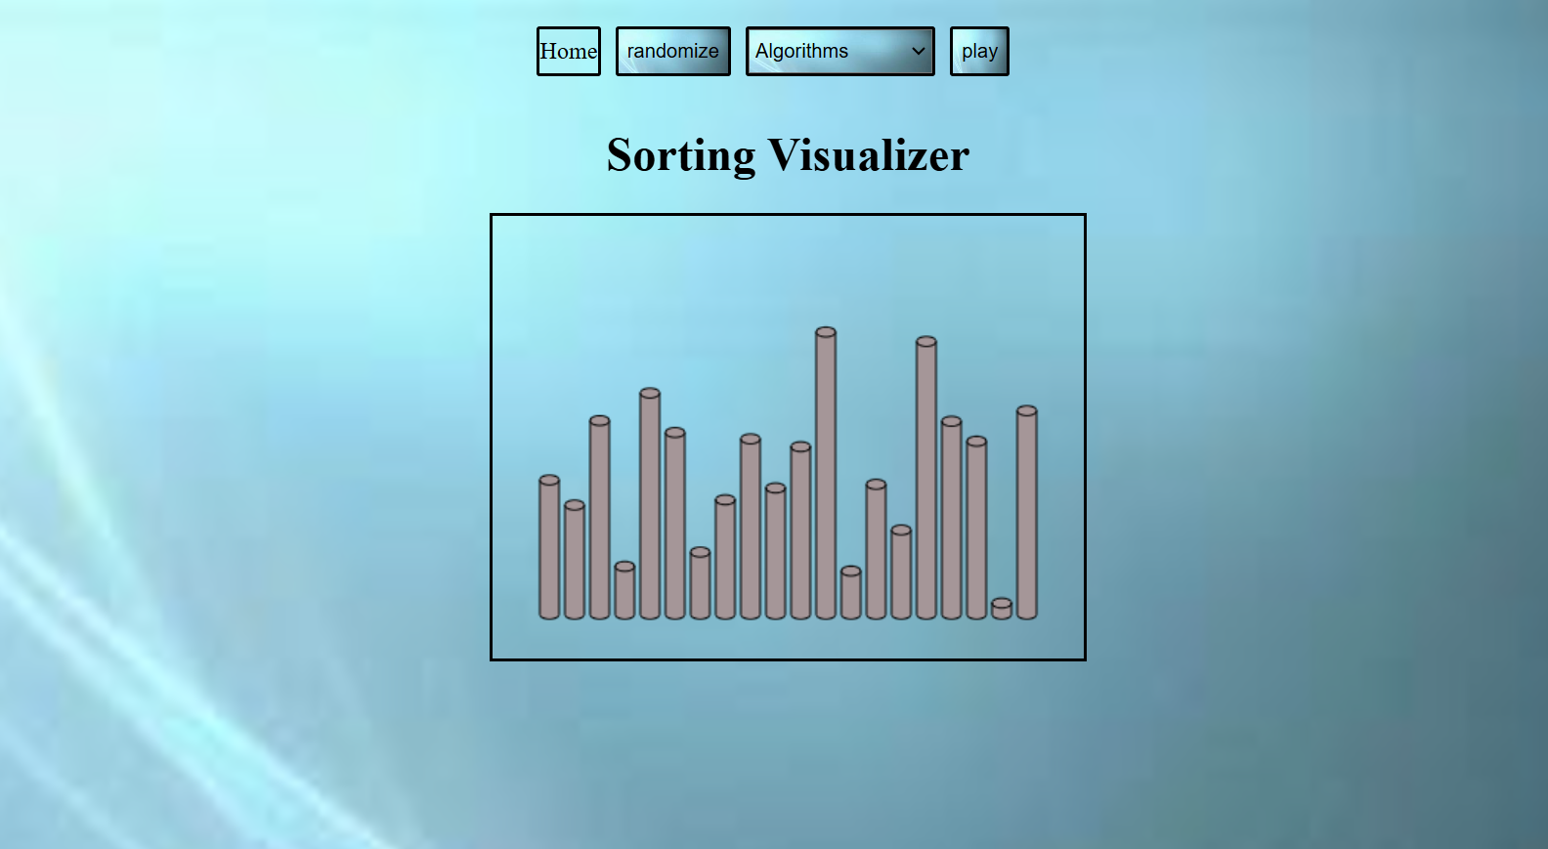
Implementation
Sorting Visualizer page
Web page of algorithm visualizer

Slide 9
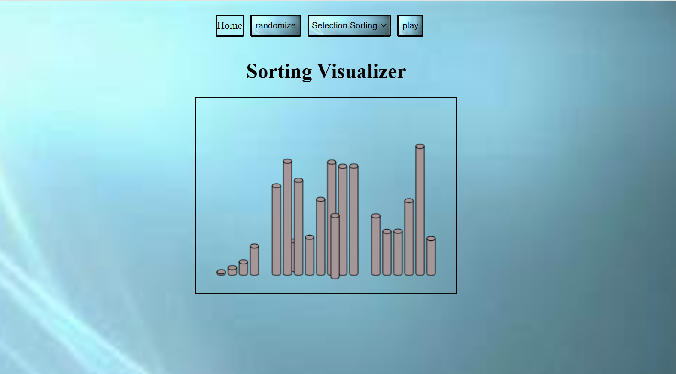
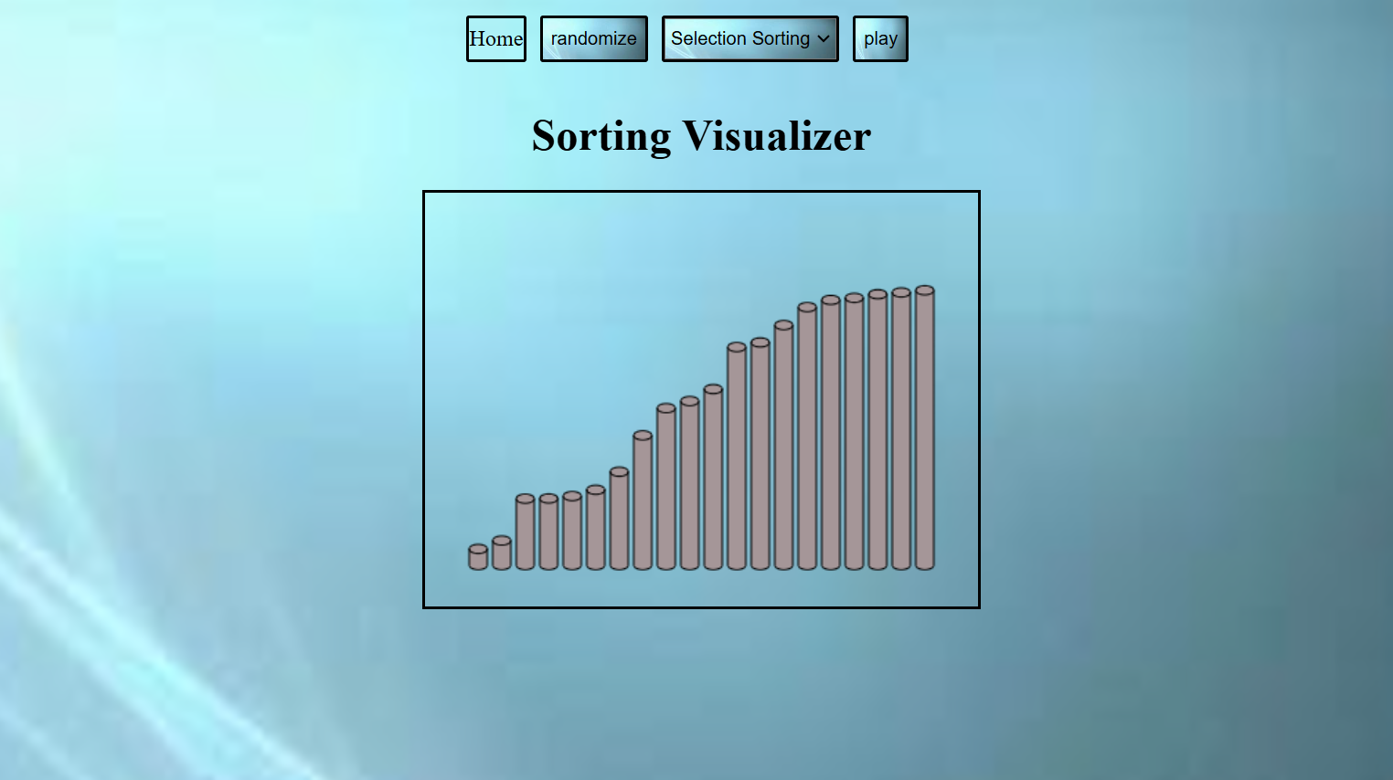
Sorted array
Selecting a sorting algorithm

Slide 10
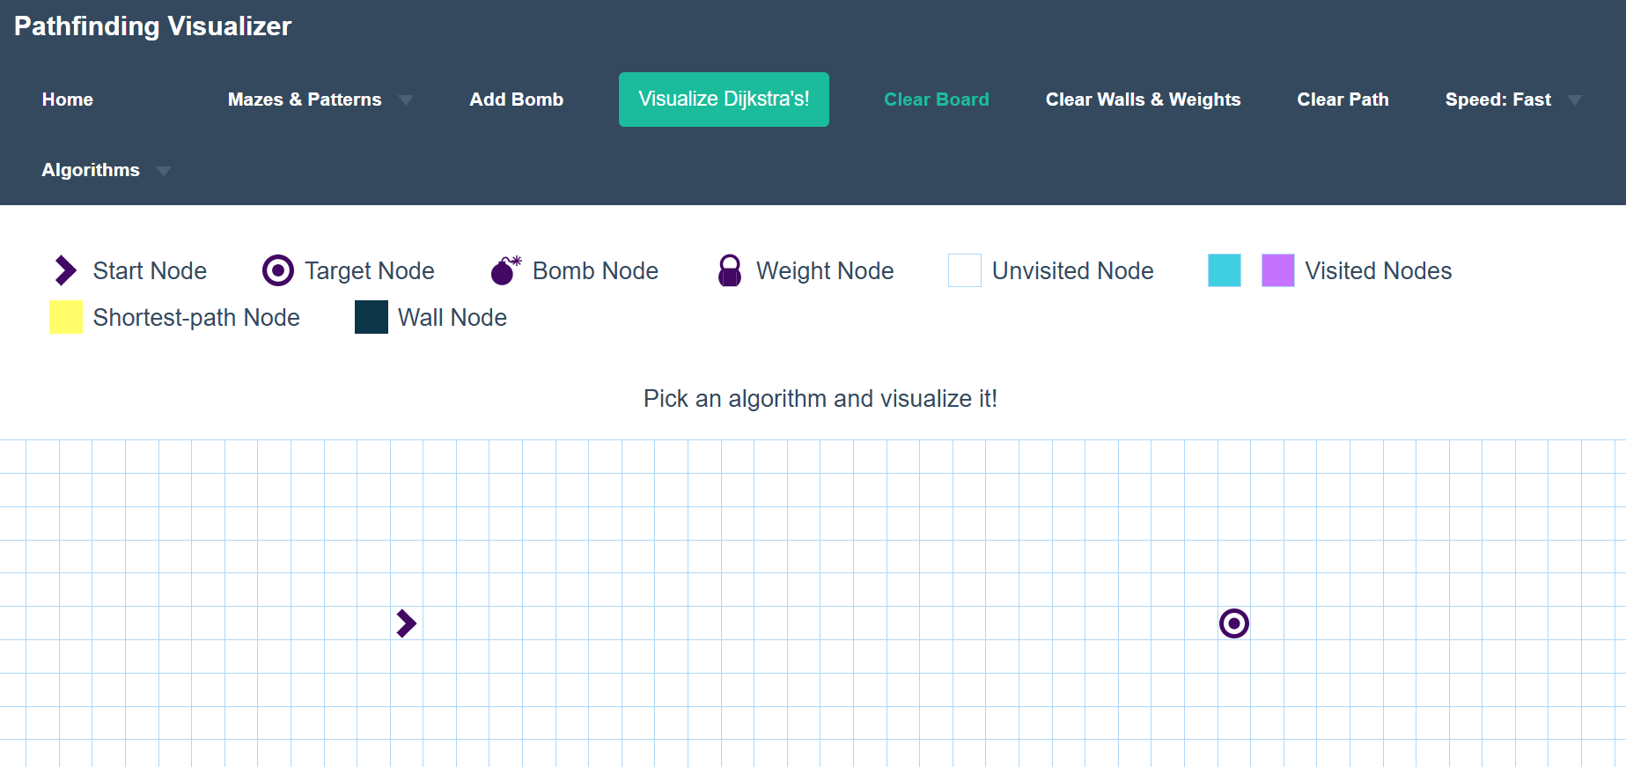
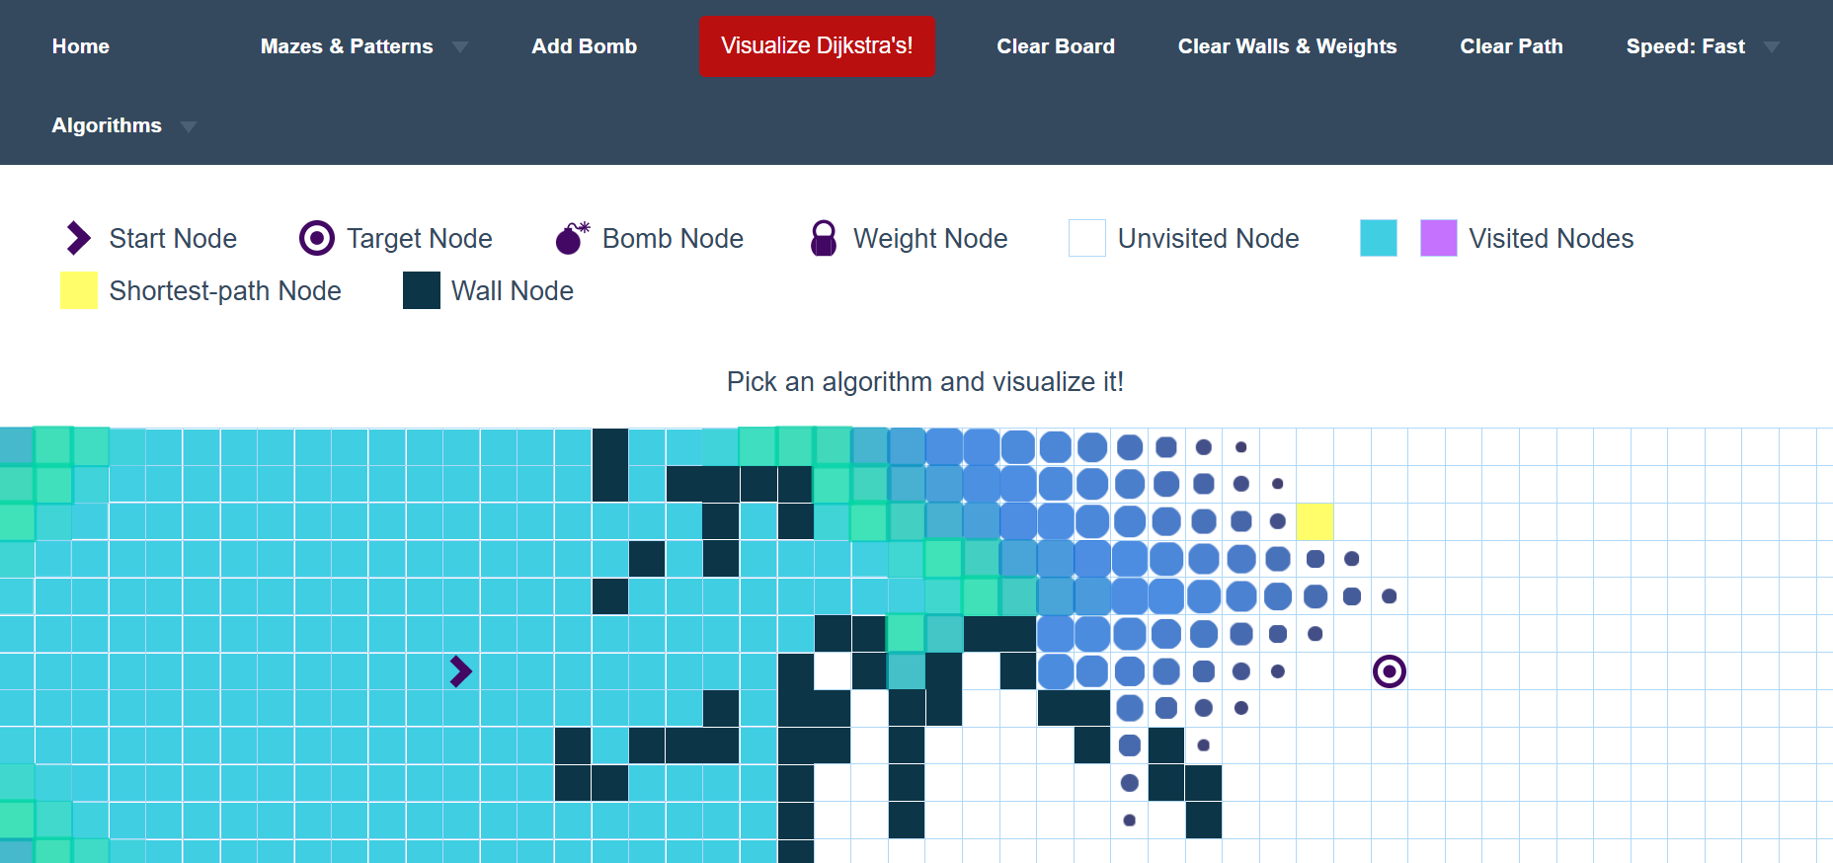
Finding a path from source node to destination node
Path finding visualizer page

Slide 11
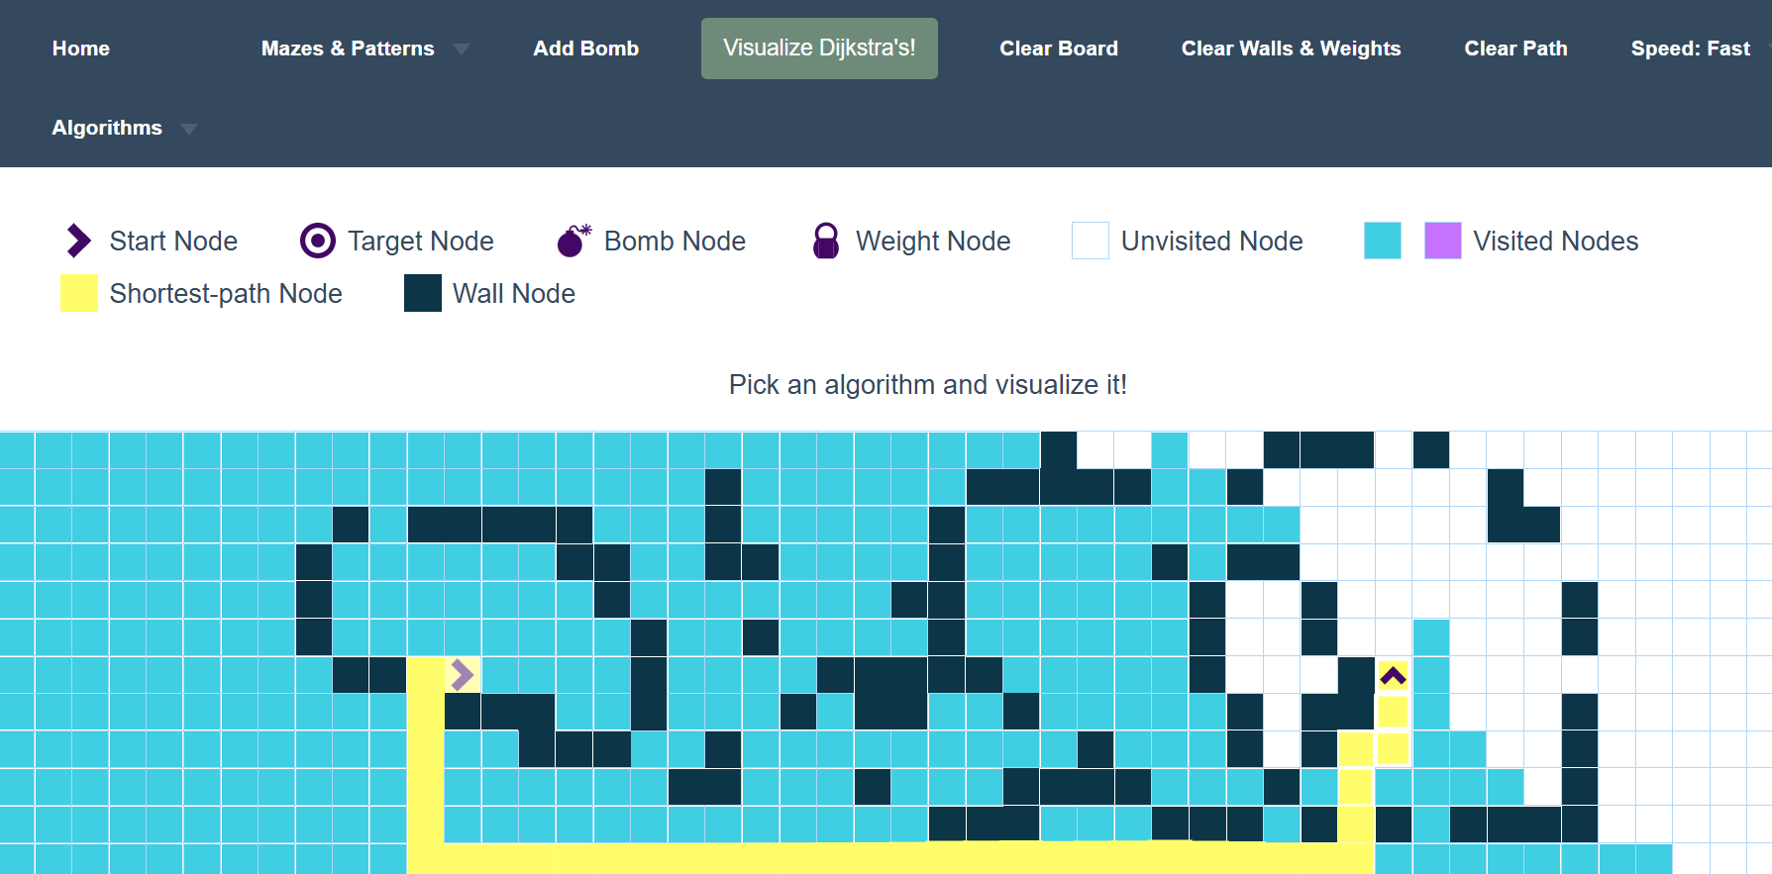
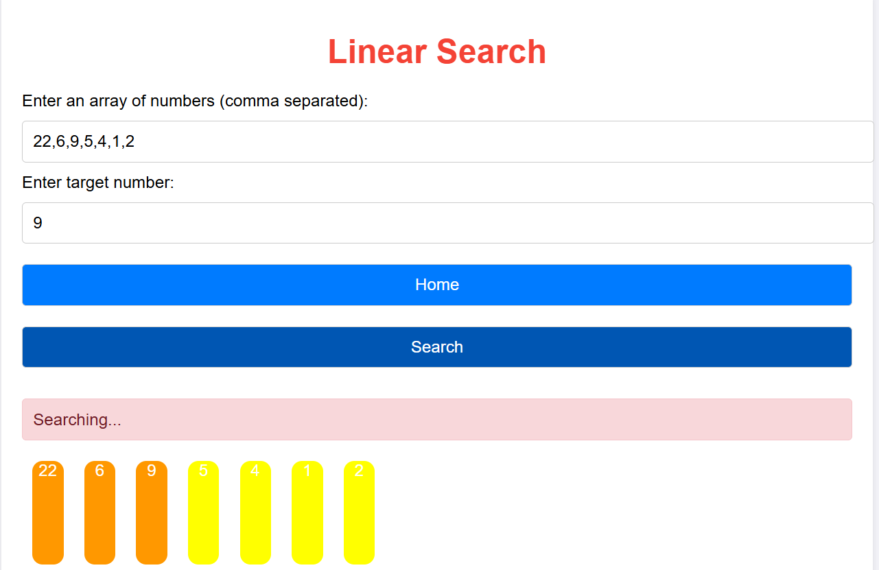
Linear search page
Found shortest path

Slide 12
Conclusion
In conclusion, the Algorithm Visualizer project provides an interactive and intuitive platform for users to understand and explore various algorithms in computer science.
By visually demonstrating how algorithms work step-by-step, it enhances learning and problem-solving skills, making complex concepts more accessible.
The project not only improves comprehension but also offers a practical tool for students, educators, and developers to experiment with and analyze different algorithms.
Overall, the visualizer serves as an effective educational resource for both beginners and advanced learners.

Slide 13
References
Jussi Nikander, Juha Helminen, and Ari Korhonen, “Algorithm Visualization System for Teaching Spatial Data Algorithms”, Journal of Information Technology Education (JITE,) 2010.
Barnini Goswami, Anushka Dhar, Akash Gupta, Antriksh Gupta, “ALGORITM VISUALIZER”, International Research Journal of Engineering and Technology (IRJET), 2021.
Slavomír Šimoˇnák “Using algorithm visualizations in computer science education”, Central European Journal of Computer Science (CEJCS), 2015.
Euripides Vrachnos, Athanassios Jimoyiannis, “Design and evaluation of a web-based dynamic algorithm visualization environment for novices”, ScienceDirect, 2013.
Arijit Goswami, Biswarup Bhattacharjee, Rahul Debnath, Ankita Sikder, “Web-Based Dynamic Algorithm Visualizer Along with Chat Engine SDK for Neophyts”, International Journal of Engineering Science and Computing (IJESC), 2021.

